Slide 1

Bank Personal Loan Modelling

Slide 2
Problem statement
Banks don’t have any prescription that easily helps them to identify potential customers who are willing to take personal loans so that the institution’s revenue is increased from new customers.

Slide 3
What should we do?
Given the customer data, we analyse the data by doing exploratory data analysis.
Then we should be able to understand who the potential customers are to target for personal loan.

Slide 4
Customer data - overview
Columns | Description | Data Range
ID | Customer ID | 1-5000
Age | Customer's age in completed years | 23-67
Experience | #years of professional experience | 0-43
Income | Annual income of the customer ($000) | 8-224
ZIP Code | Home Address ZIP code. | Starting in the range(91-96
Family | Family size of the customer | 1-4
CCAvg | Avg. spending on credit cards per month ($000) | 0-10
Education | Education Level. 1: Undergrad; 2: Graduate; 3: Advanced/Professional | 1-3
Mortgage | Value of house mortgage if any. ($000) | 0-635
Personal Loan | Did this customer accept the personal loan offered in the last campaign? | 0,1
Securities Account | Does the customer have a securities account with the bank? | 0,1
CD Account | Does the customer have a certificate of deposit (CD) account with the bank? | 0,1
Online | Does the customer use internet banking facilities? | 0,1
CreditCard | Does the customer use a credit card issued by Universal Bank? | 0,1

Slide 5
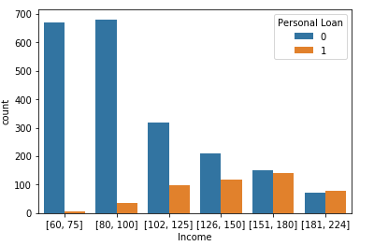
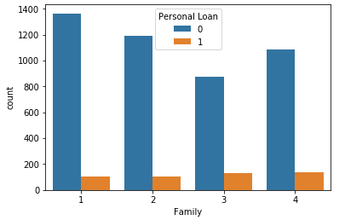
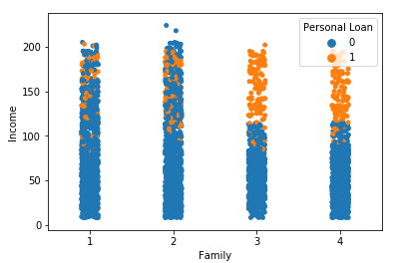
Income >115k and family>2 defaults to personal loan
Insights:
In each income range above 100 there are around 20-50 percent of people opting for personal loan. Below 100 income range we have only 1-5 percent of people opting for personal loan.
Family count 3 and 4 has 10 to 15 percent of people opting for personal loan whereas other two categories have only 7-8 percent.
100 percent of people with income greater than 115 and with family size 3 or 4 have opted for personal loan

Slide 6
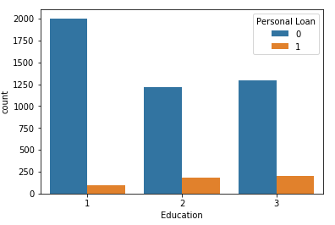
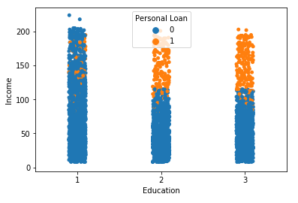
Income > 115k and Education >1 defaults to personal loan
Insights:
Education 2 and 3 category has 13 to 15 percent of people opting for personal loan. Whereas Education 1 category has only 4 percent of people opting for personal loan.
100 percent people with income greater than 115 and in education 2 and 3 category have opted for personal loan
Education is associated with personal loan.

Slide 7
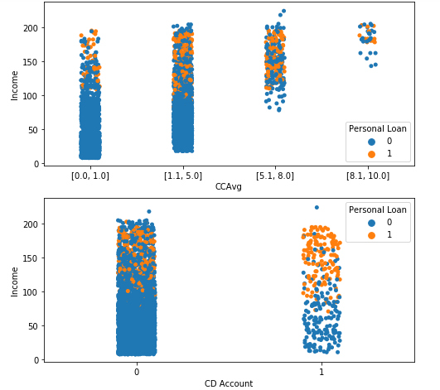
CCAvg>5 or CDAccount=1 , around 50 percent opted for personal loan
Insights:
In case of CCAvg greater than 5 we can see that the proportion of people opting for personal loan is around 45 to 50 percent. Whereas in less than 5 category it is just 4-10 percent.
CDAccount 1 category has around 47 percent of people opting for personal loan. Whereas in CDAccount 0 it is just 7 percent.
Both CCAvg and CDAccount has some effect on personal loan.
In CCAvg above 5 category, all people are with income greater than 77k.

Slide 8
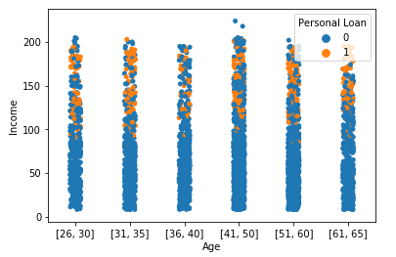
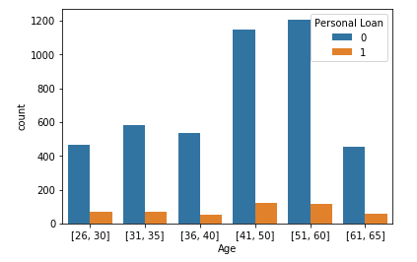
Age-negligible impact on personal loan
Insights:
In all age groups around 8 to 10 percent of people have opted for personal loan. The effect of age on personal loan is negligent.

Slide 9
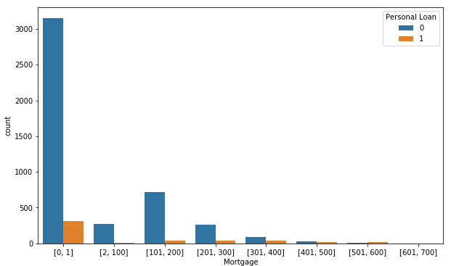
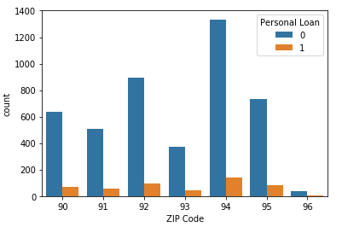
Mortgage, Zipcode – trivial impact on personal loan
Insights:
Mortgage values greater than 300 seems to have 40 to 60 percent of people opting for personal loan. But as the number of people in this range is very less, we can neglect this.
Like age column, 7.5 to 10 percent of people are opting for personal loan across all zip codes. So this has negligible effect on personal loan.

Slide 10
Conclusion
Income, Family, Education, CCAvg, CDAccount are the features identified as related to personal loan.
Age, Zip code, Mortgage, Online, Securities are the features which do not affect personal loan.
Income and CCAvg features have a slight positive correlation. Other features are independent of each other.
100 percent people with income greater than 115 and with family size greater than 2 or in education greater than 1 category have opted for personal loan.
Also in CCAvg greater than 5 and CDAccount 1 category 47 to 50 percent of people have opted for personal loan.
Below is the best category of people to be targeted.
1. Income greater than 100
2. Family greater than 2
3. Education greater than 1
4. CCAvg greater than 5
5. CDAccount equal to 1

